Slide 1
Recruitment of cortical areas in the telemetry ward after implantation
(recordings from scalp, subdural frontal strips and thalamic electrodes)

Slide 2
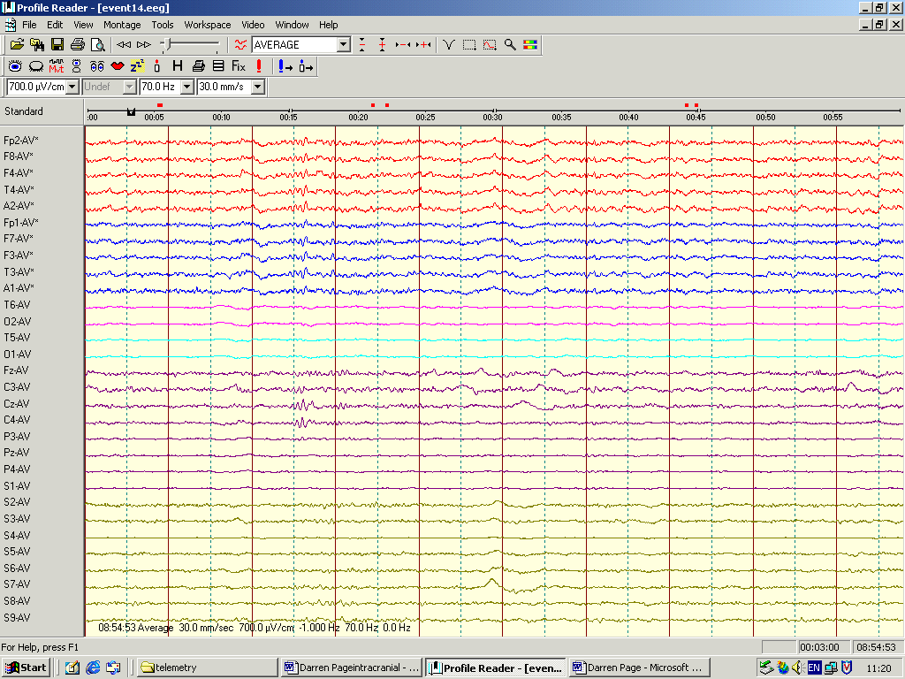
Telemetry recordings
Right scalp
Left scalp
Left Thalamic electrode
Right Thalamic electrode
Left Frontal strip
Right Frontal strip
2
3
2
3
1
2
3
4
5
6
7
8
1
2
3
4
5
6
7
8

Slide 3
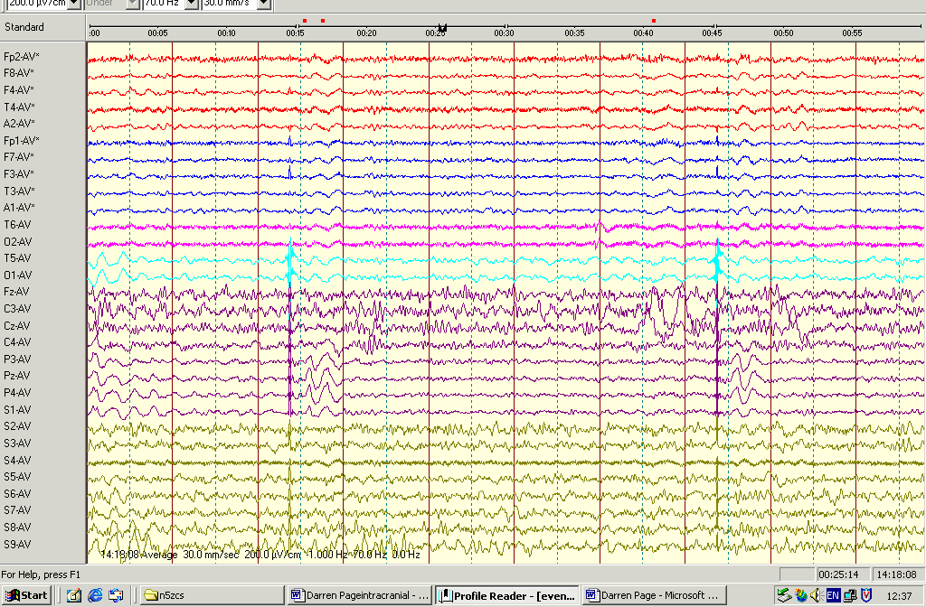
Left Thalamic Single Pulse Electrical Stimulation
RS
LS
LTh
RTh
LFS
RFS

Slide 4
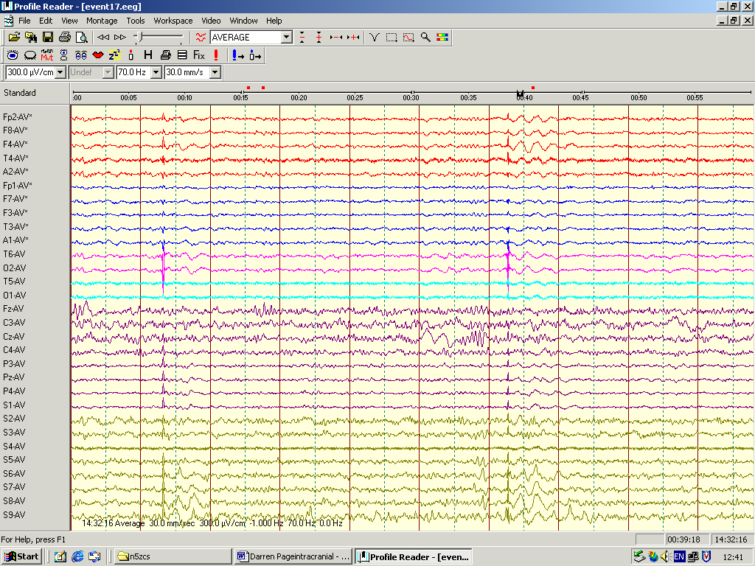
Right Thalamic Single Pulse Electrical Stimulation
RS
LS
LTh
RTh
LFS
RFS

Slide 5
Interictal activity

Slide 6
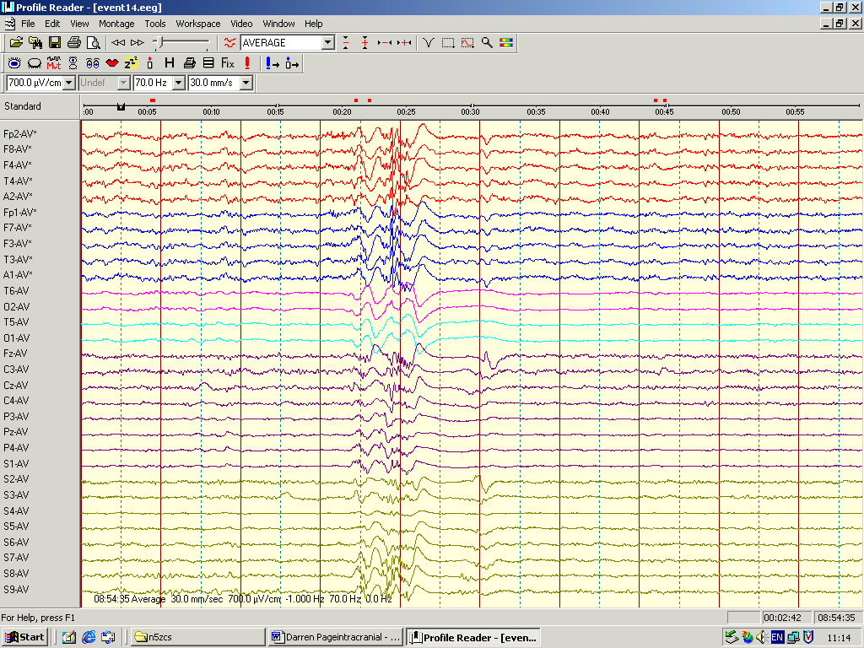
RS
LS
LTh
RTh
LFS
RFS

Slide 7
Subclinical seizures

Slide 8
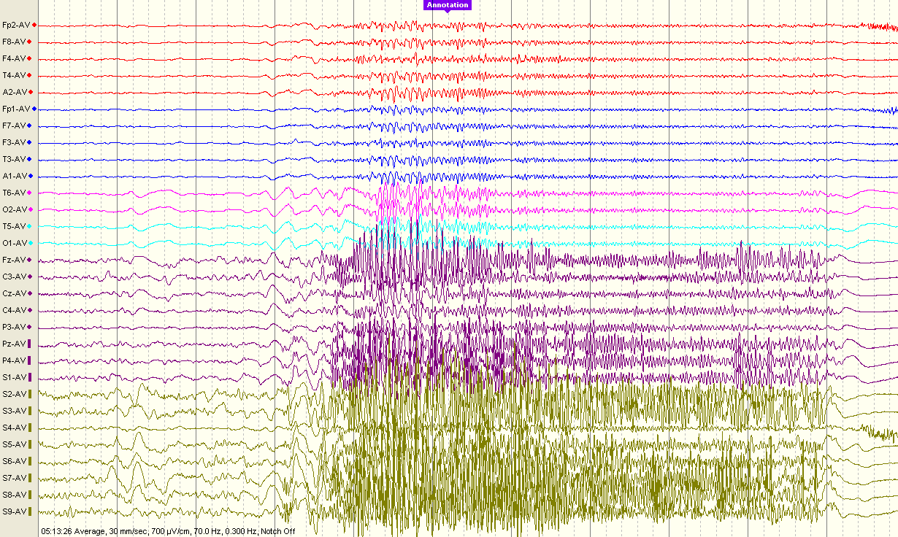
Seizure reference montage
Right scalp
Left scalp
Left Thalamic electrode
Right Thalamic electrode
Left Frontal strip
Right Frontal strip
2
3
2
3
1
2
3
4
5
6
7
8
1
2
3
4
5
6
7
8

Slide 9
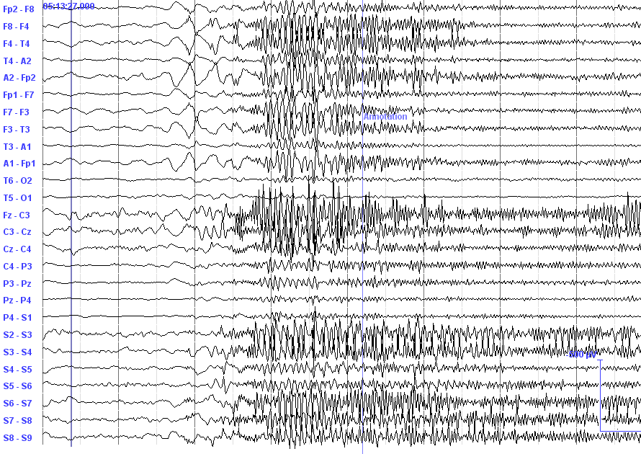
Seizure bipolar montage
Right scalp
Left scalp
Left Thalamic electrode
Right Thalamic electrode
Left Frontal strip
Right Frontal strip

